Slide 1

GROCERY RECOMMENDATION SYSTEM FOR RETAIL MARKERTS
ARTIFICIAL INTELLIGENCE AND MACHINE LEARNING
DEPARTMENT OF COMPUTER SCIENCE AND ENGINEERING
BY
CH .NARESH (18481A0539)
CH.PAVAN KUMAR (18481A0541)
B.VASANTHI (18481A0530)
CH.NIKHITHA (18481A0551)

Slide 2
Introduction:
Recommender Systems are intelligent engines that gather information relevant to which product a customer has seen or bought previously, with the objective of providing personalized suggestions on unobserved items that are likely to be interest. It analyses the needs of customers and suggest the best possible shopping list. Most of the customers would like to have recommendation system because they can gain access to know about the feedback given by other customers.

Slide 3
ABSTRACT :
Grocery recommendation system for retail markets focuses on building a system where cameras at entry recognize the customer and link his previous purchases history stored in the database. Based on the purchased history he will get a recommendation of offers on the product which he wishes to buy. And also displays on the screen at the entrance as soon as he steps into the store.

Slide 4
Problem statement :
Customers who seek the services at supermarkets are subjected to inconsistencies & ambiguities over choosing their desired products from a wide range of products with the closest quality. Meanwhile, supermarkets find it very difficult to satiate the customers’ demand.

Slide 5
Scope :
Therefore, proposing a method to analyze the customers’ need plays an important role in attracting new and regular customers. The purpose of this study is to formulate a product recommendation system which analyze customers’ needs and thus recommend the best products.

Slide 6
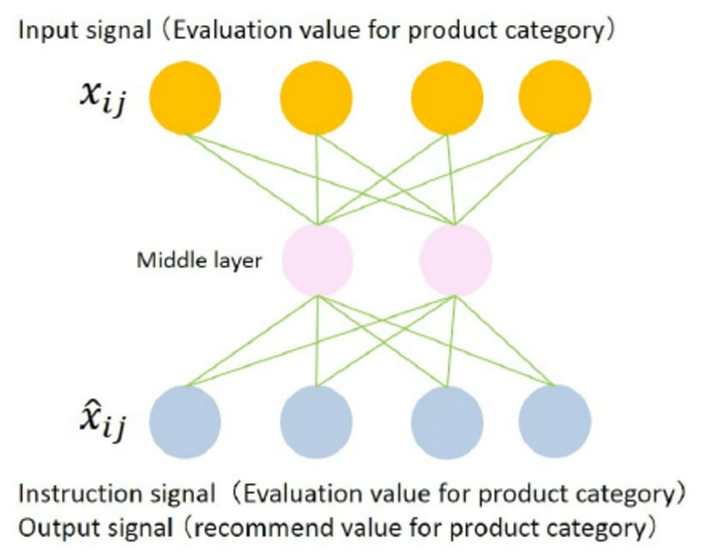

Slide 7
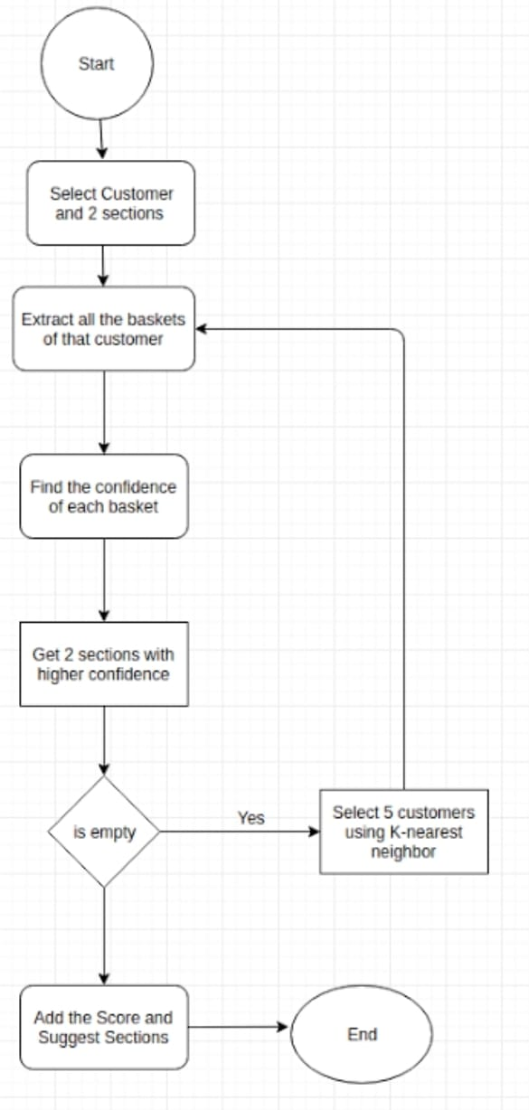
Flow chart:

Slide 8
Advantages:
Increasing customer loyalty with interesting offers.
Growth of purchase and therefore business profit.
Opportunity to meet customers and understand their needs better.
Broadening customer minds due to offering items that are relevent to their shopping basket.

Slide 9
Project requirements:
A classification algorithm with maximum accuracy to be trained and tested on the dataset.
The dataset consists of 8 clumns excluding the predicting column.

Slide 10
Software requirements:
IBM cloud
IBM watson studio
Node-red app

Slide 11
Thank you!

